Slide 1
Choropleth Maps & Candlestick Charts using Plotly
Presented by
Madanamohan Reddy Govindu
Course: (44-599) Introduction to Data Visualization
April 18, 2017

Slide 2
Agenda
A brief introduction on Choropleth Maps and Candlestick Charts.
Plotly?
Goals.
Data source.
Generating Choropleth Maps and Candlestick Charts using the data from data source.
Plotly tool demonstration.
Advantages and Limitations.
Lessons Learned.
Conclusion.

Slide 3
Choropleth Map?
A choropleth map is a thematic map in which areas are shaded or patterned in proportion to the measurement of the statistical variable being displayed on the map.
Provides an easy or excellent way to visualize how a measurement varies across a geographic area and the level of variability within a region.

Slide 4
Choropleth Map?(Cont’d)
Broadly speaking choropleths represent two types of data:
1. Spatially extensive data.
2. Spatially intensive data.
Color Progression: Several different types of color progressions used by cartographers. Mainly,
1. Single hue progression ( )
2. Bi-polar color progression( )
Notes:
Spatially extensive data: Things like populations. The population of the UK might be 65 million, but it would not be accurate to arbitrarily cut the UK into two halves of equal area and say that the population of each half of the UK is 32.5 million.
Spatially intensive data: Things like rates, densities and proportions, which can be thought of conceptually as field data that is averaged over an area. Though the UK's 60 million inhabitants occupy an area of about 240,000 km², and the population density is therefore about 250/km², arbitrary halves of equal area would not also both have the same population density.
Color Progression:
Single hue progression: The darkest hue represents the greatest number in the data set and the lightest shade representing the least number.
Bi-polar color progression: For example, a typical progression when mapping temperatures is from dark blue (for cold) to dark red (for hot) with white in the middle.

Slide 5
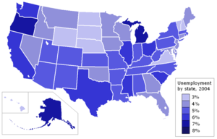
Choropleth Map?(Cont’d)
Fig: Choropleth Map showing unemployment in The United States.
Image source: http://wiki.gis.com/wiki/index.php/Choropleth_map
Notes:
In the figure, the legend represented using “Single hue progression”.

Slide 6
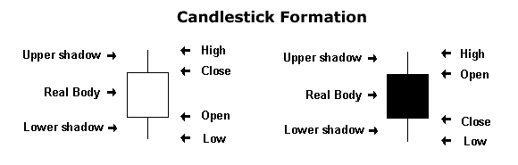
Candlestick Charts?
In order to create a candlestick chart, we must have a dataset that contains open, high, low and close values for each time period you want to display.
Notes:
1. Open – opening price, close – closing price and low, high – is like 52-week low/high is the highest and lowest price that a stock has traded.
2. The first diagram is called Hollow candlestick chart and the second one is called Filled candlestick chart.

Slide 7
Candlestick Charts?(Cont’d)
The hollow or filled portion of the candlestick is called “the body”.
The long thin lines above and below the body represent the high/low range and are called “shadows”.
The high is marked by the top of the upper shadow.
The low is marked by the bottom of the lower shadow.
Notes:
Shadows are also referred as “wicks’ and “tails”.

Slide 8
Candlestick Charts?(Cont’d)
If the stock closes higher than its opening price, a hollow candlestick is drawn.
If the stock closes lower than its opening price, a filled candlestick is drawn.
Long white candlesticks show strong buying pressure.
Long black candlesticks show strong selling pressure.
Notes:
1. Generally speaking, the longer the body is, the more intense the buying or selling pressure. Conversely, short candlesticks indicate little price movement and represent consolidation.

Slide 9
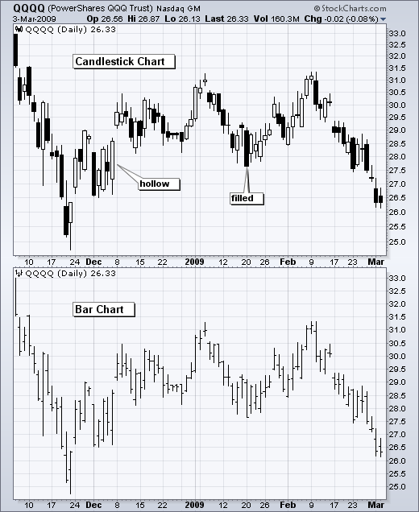
Candlestick Charts vs Traditional Bar Charts?
Image source: http://stockcharts.com/school/doku.php?id=chart_school:chart_analysis:introduction_to_candlesticks
Notes:
Compared to traditional bar charts, many traders consider candlestick charts more visually appealing and easier to interpret.
Each candlestick provides an easy-to-decipher picture of price action. Immediately a trader can compare the relationship between the open and close as well as the high and low

Slide 10
Plotly?
Plotly, also known by its URL, Plot.ly, is an online analytics and data visualization tool.
Plotly is the collaboration platform for modern data science which provides online graphing, analytics, and statistic tools for both individuals and collaboration.
Plotly is free and online which lets you to control your data and privacy.
Notes:
1. Plotly was named one of the Top 20 Hottest Innovative Companies in Canada by the Canadian Innovation Exchange.
2. Plotly was featured in "startup row" at Pycon 2013.

Slide 11
Plotly?(Cont’d)
Plotly was built using Python and the Django framework, with a front end using JavaScript and the visualization library D3.js, HTML and CSS.
Online files are hosted on Amazon S3.
Easily create stunning and informative graphics using the sophisticated, open source, visualization library and with the online chart creation tool.
Notes:
Django is a free and open-source web framework, written in Python, which follows the model-view-template(MVT) architectural pattern.
Django's primary goal is to ease the creation of complex, database-driven websites.
Amazon S3 (Simple Storage Service) is a web service offered by Amazon Web Services. Amazon S3 provides storage through web services interfaces (REST, SOAP, BitTorrent).

Slide 12
Plotly?(Cont’d)
Plotly supports working with different data storage environments like Microsoft Access, Databases(both SQL and NoSQL).
Currently Plotly supports six main products:
1. Plot.ly 4. API libraries
2. Plotly.js 5. Figure Converters
3. Plotly Enterprise 6. Plotly Apps
Currently supports more than 25 chart types.

Slide 13
Connecting MySQL to Plotly?
Required resources:
Database: MySQL.
Server: Plotly Database Connector.
Web tool: Plotly. Create
MySQL-connector-python
System environment:
Visual C++ redistributable Python(Create path).
.

Slide 14
Goals
Goal 01: Generating a Choropleth map by importing data from MySQL database to plotly workspace- online chart editor using Virtual-Plotly Database Connector server.
Goal 02: Importing data from MySQL database to generate a Candlestick chart.

Slide 15
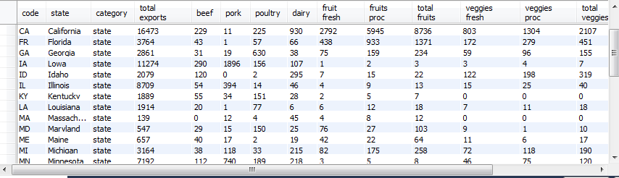
Goal 01 - Data source
Got data from “The World Fact book” and created table in MySQL with same data.
“T
Database Name: usa_agri_exports_2011 Records: 35, Attributes: 17

Slide 16
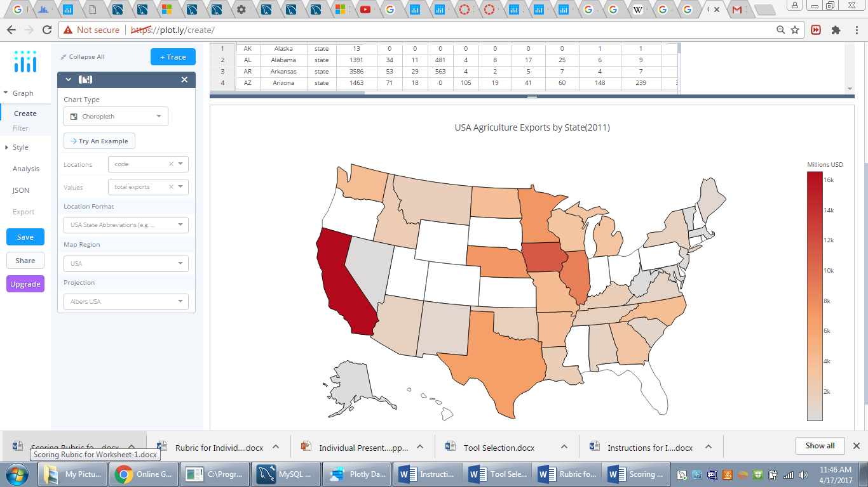
Choropleth Map for Goal 01

Slide 17

Demonstration

Slide 18
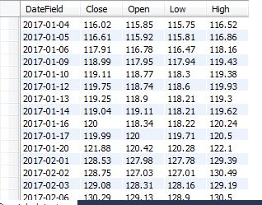
Goal 02 - Data source
Inserted arbitrary data into MySQL database.
Database Name: candlestickchart_data Records: 20, Attributes: 05

Slide 19
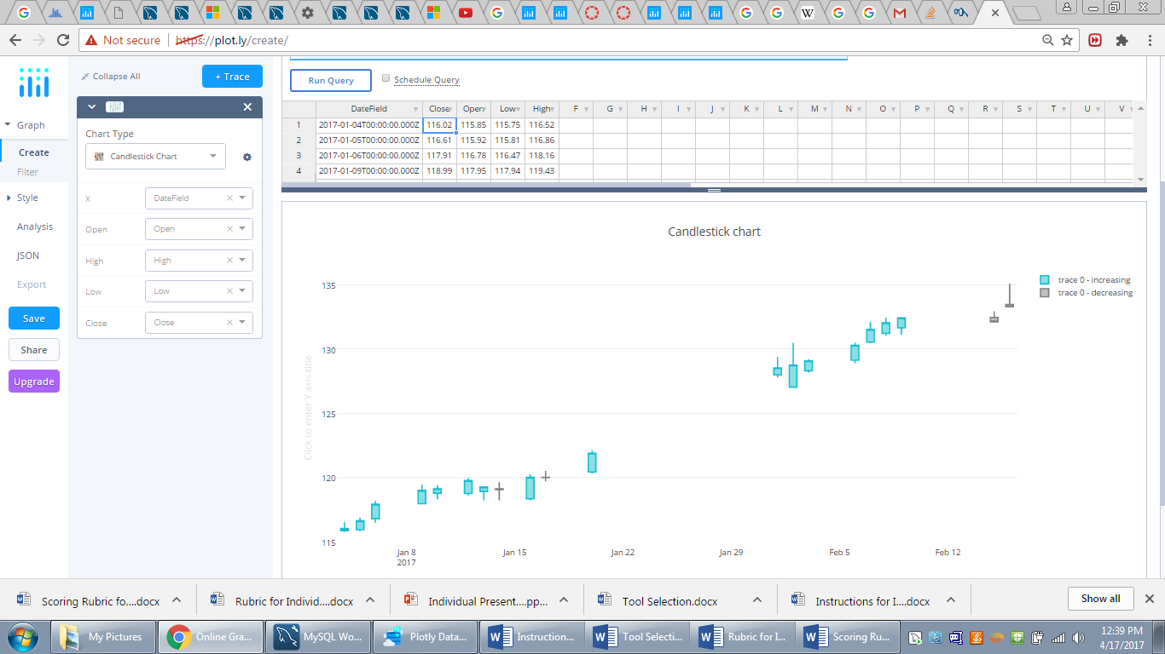
Candlestick Chart for Goal 02

Slide 20
Demonstration

Slide 21
Advantages
No installation required.
Easy to Use
Constantly growing number of supported chart types
Work online from any device at any location.
You own and control your data and privacy.

Slide 22

Limitations
Not many features are available for free version.
Need to install several software to import data from database to plotly tool.
Fig - 6. Limitations Image

Slide 23
Lessons Learned
Got working knowledge on MySQL
Understood various visualizations that can be done using Plotly.
Got to know the importance of visualizing the right chart or diagram for the appropriate data.
From this course, I learnt we should want to deduct some information from the chart/diagram that we created.

Slide 24
Conclusion
With the help of Plotly tool, generated choropleth and candlestick charts for the data imported from MySQL database by using plotly-database-connector as a server.

Slide 25

Queries?

Slide 26
THANK YOU

